Slide 1
How to do a QE Preparation
Kwok Chin Yuen
PhD Candidate year 3
PhD Topic: Domain Adaptation approaches for end2end ASR models

Slide 2
A. Introduction
Background:
As to the university requirement, I need to do QE in this semester
To write:
QE report
QE slides for QE presentation
Motivation:
As it is the first time writing long chapters for QE, how should I start?
Not sure what to write
I can kind of see how others do it by looking at their QE
However, it is not obvious how they prepared
A good preparation can guide you through the later writing process

Slide 3
B. Idea
Prof notices my challenges and teaches me for the QE preparation
There are mainly 3 stages:
Write up a list of questions
Put the questions into slides, add points to each questions
In the QE report write to answer each question, expand the points into longer sentences

Slide 4
C. Write up a list of questions
Things to consider:
Write the questions in a cascaded format
From section to subsection
From subsection to sub-subsection
Don’t cascade too much
Indicate the number of pages to write for each question / section
The questions should flow logically
Sections to write:
Introduction
Literature Review
Baseline methods
Proposed methods
Conclusion and future work

Slide 5
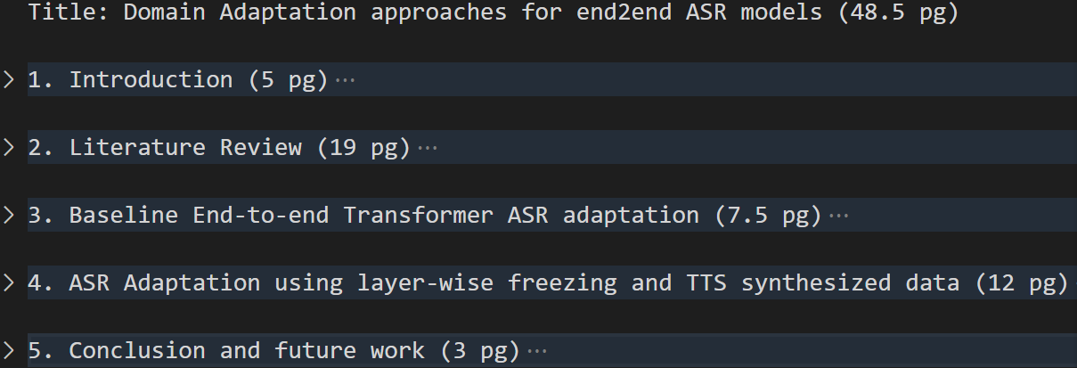
C. Example 1

Slide 6
D1. Questions for Introduction Section
Things to consider:
Subsections to write:
Background
Motivation
Contribution
Report Outline
Background
Prior knowledge about the topic
The broadest overview of the topic

Slide 7
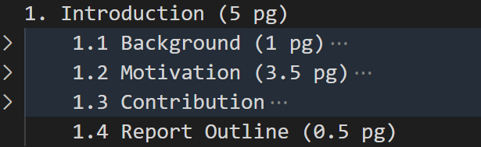
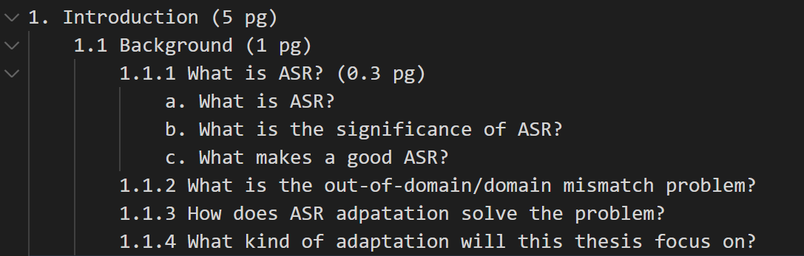
D1. Example 1

Slide 8
D1. Questions for Introduction Section
Things to consider:
Motivation
Problem -> limit scope
Technical gap
How other works solve it
Good story telling: 3 little pigs
Contribution
How we solve it

Slide 9
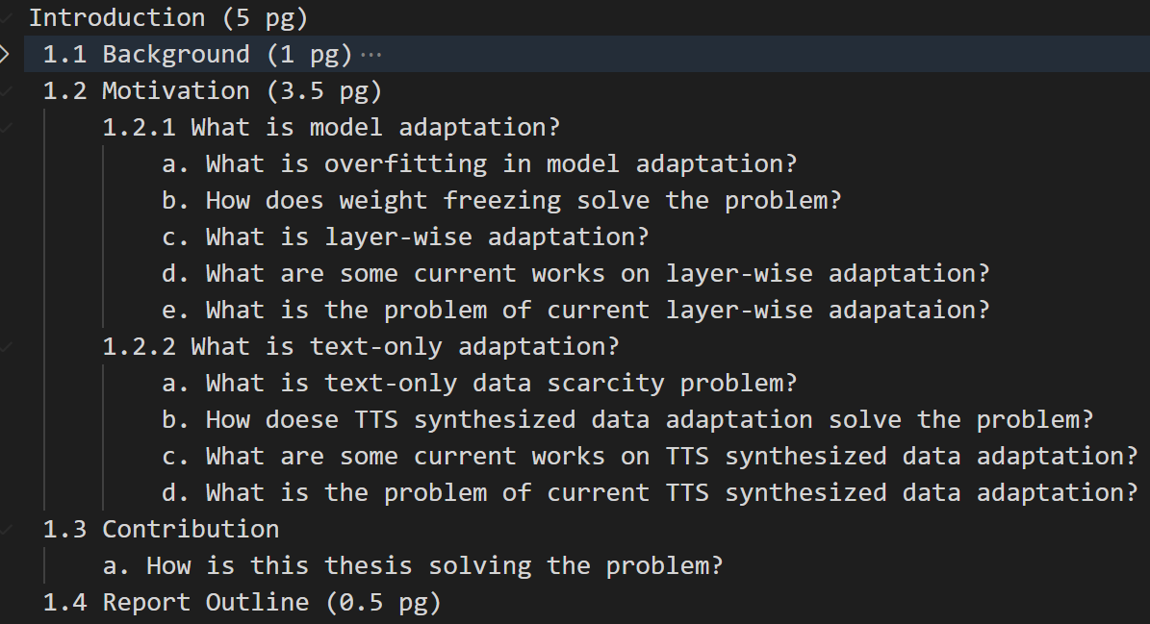
D1. Example2

Slide 10
D2. Questions for Literature Review
Things to consider:
Write overview for each concept in the QE title
Example: Domain Adaptation approaches for end2end ASR models
Subsections to write:
Overview
Overview 1
Overview 2
Summary
Ask questions more on How and Why, not what
Example: Why do we need domain adaptation?
Give whole taxonomy, then focus on parts that the proposed method is under
Example: proposed method = layer adaptation, falls under = regularized adaptation

Slide 11
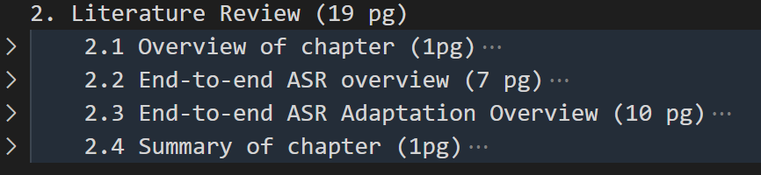
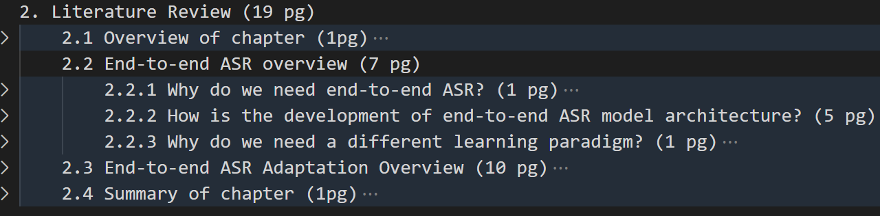
D2. Example

Slide 12
D3. Questions for Baseline Methods Section
Things to consider:
Subsections to write:
Overview of chapter
Corpus and metric
Baseline 1
Baseline 2
Summary of chapter
For corpus, give list of available corpus, and explain why you choose certain corpus in experiments

Slide 13
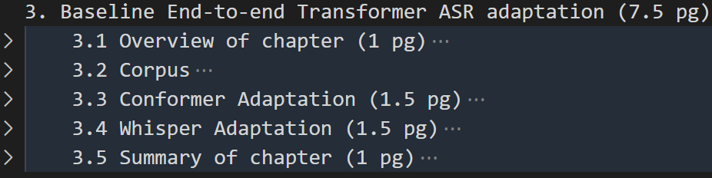
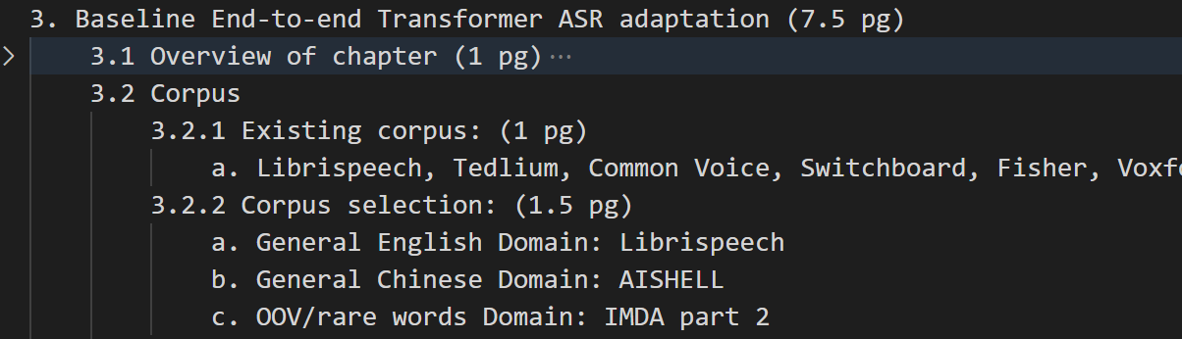
D3. Example

Slide 14
D4. Questions for Proposed method Section
Things to consider:
Subsections to write:
Overview of chapter
Proposed method 1
Proposed method 2
Summary of chapter
In proposed method subsection, there should be related work
This related work has smaller scope than Literature Review
Example:
Proposed method: layerwise adaptation
Literature Review: Regularized adaptation. Includes layerwise adaptation, instance weighting
Proposed method related work: different kinds of layerwise adaptation

Slide 15
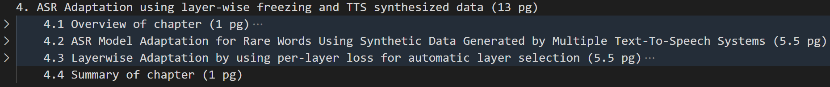
D4. Example

